Slide 1




FinTech – Project: 1
12th April 2021
Human
ROBOMystic
Coney
Dipendra
Justin
Sherin
Yu.

Slide 2
MOTIVATION & SUMMARY
To develop an intelligent, interactive interface that allows for the customization of securities portfolios for a diverse range of clientele.
Our company specializes in analyzing American securities for clients looking for exposure to U.S. markets
S&P 500 Index is our benchmark
Our analysis covers:
Statistical Analysis: Beta, Standard Deviation, Variance, Covariance, and Sharpe Ratios
P/E Ratios and Total Shareholder Return
Rolling Statistics
Portfolio Returns
Culmination
Monte Carlo simulations / confidence intervals
Our analysis is based on 20 years’ of historical data
Data Sets to Incorporate:
S&P Sector Indices
What is our investment strategy?:
For our most conservative clients, we offer index investing that follows the S&P 500
For our moderately risk tolerant clients, we offer what is essentially an S&P 500+ category
For our highly risk tolerant clients, we offer an S&P 500++
Summary of Findings

Slide 3
Questions & Data
Provide more detail on the questions posed, including what kind of data was needed to answer them, and where it was found.
Data Cleanup & Exploration:
We used YahooFinance ( so very minimal data cleaning) Json was used and altered to derive results
Describe the exploration and cleanup process.
Discuss any insights you had while exploring the data that you didn't anticipate.
Discuss any problems that arose after exploring the data, and how they were resolved.
Present and discuss interesting figures developed during exploration, ideally with the help of Jupyter Notebook.
PROJECT PROPOSAL
Project Details
Title | TBD: Human-Robo Advisory; Robo-Vascular; Robo-FA; Investo-MAX(? After BayMax);
Description | Investment portfolio builder that allows flexibility in portfolio distribution (ratio) Benchmarking of portfolio: (1) S&P 500 (top 10 or 20 per industry); (2) peers (based on market cap and/or revenue) Robo-advisory dashboard Feature (Project 2): Contingency Planning - JUSTIN - Forecasting portfolio performance on catastrophic situations leading to extreme volatility (Sharpe Ratio)
Data Scope | Company background and basic info (market cap, size, etc.) Historical stock prices and trending (TDB: 20 years max)
Geographical Scope | US Market (& possibly CAN on PROJ2) S&P 500 (will expand further as the project progresses)
Calculations (Financial Performance) | *Already in Y!Finance API Market Cap* Beta* PE Ratio* EPS* Sharpe Ratios Standard Dev Mean Volatility Indexing Rolling Stat Portfolio Returns (Other possible criteria to consider) - CONEY Total (YE) Revenue Net Income (Loss) EBITDA (Earnings Before Interest and Taxes and Depreciation) EPS Y/Y Growth (%) RoE (Return on Equity %) RoA (Return on Assets %) RoI (Return on Investments %) Debt/Asset Ratio Debt/Equity Ratio Total shareholder return MARKET CAP Sources: https://financialmodelingprep.com/developer/docs/formula/ https://medium.com/swlh/intrinsic-valuation-of-stocks-using-python-5d902a34b1a0
Dashboard | KYC (Age, Risk Appetite, other factors) - JUSTIN
Libraries | YAHOO FINANCE - pip install yahoo-finance SOURCE: https://pypi.org/project/yahoo-finance/ FINANCIAL FUNDAMENTAL ANALYSIS - pip install FundamentalAnalysis SOURCE: https://pypi.org/project/FundamentalAnalysis/

Slide 4

Know Your Client / Onboarding: We have selected the .yaml file format to mimic how data from multiple clients would usually be received and processed by a brokerage.
.yaml stands for "YAML Ain't Markup Language" and is a data-serialization language designed to be readable by humans and to have compatibility with python and JSON files, which make it useful for storing and transmitting data.
We have selected it so our clients can fill out KYC forms with applicable information, such as their annual incomes, risk tolerance, investment objectives, and the time horizons for their investments to name a few.
Once we have received our clients' forms, we import them into our powerful, proprietary software and transform the data into pandas dataframes, which then allow us to call items from the respective columns and rows of data to feed our selection algorithms, allowing us to categorize the client and assign to them the appropriate portfolio.

Slide 5

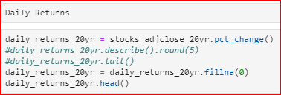
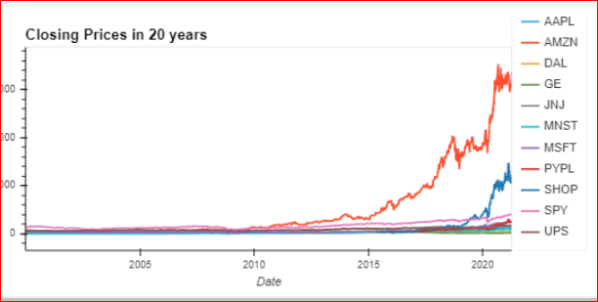
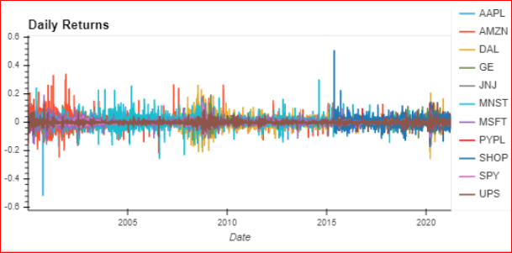


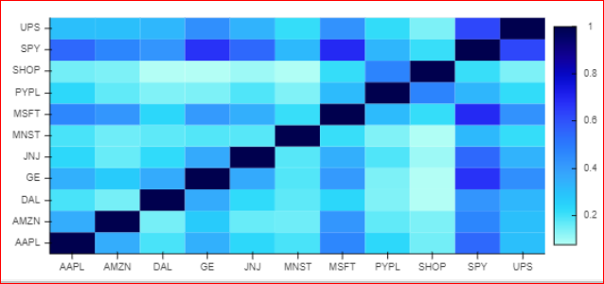
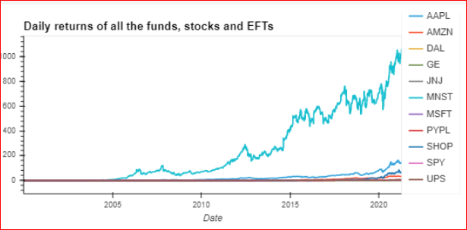
STOCK SELECTION
['SPY','AAPL','AMZN','DAL','GE','JNJ','MSFT','MNST','PYPL','SHOP','UPS']
Cumulative and Correlation

Slide 6
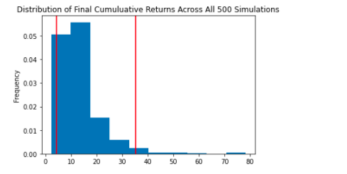
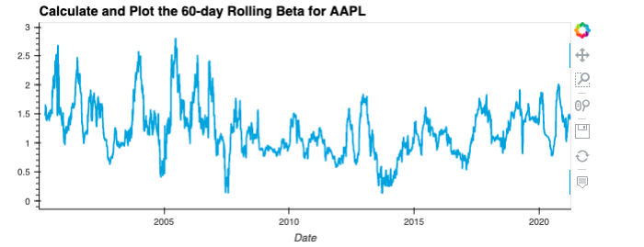
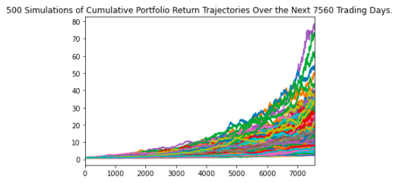
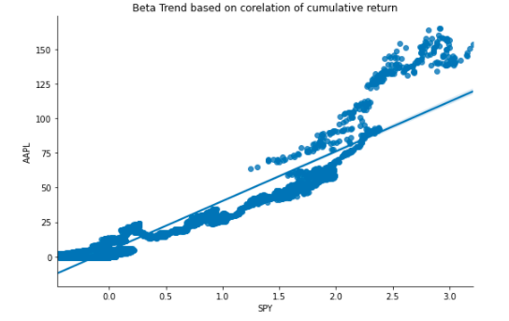
Portfolio Assignment & Analysis (Monte Carlo & Beta)

Slide 7
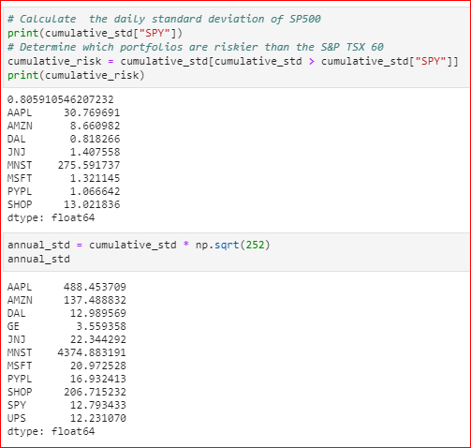

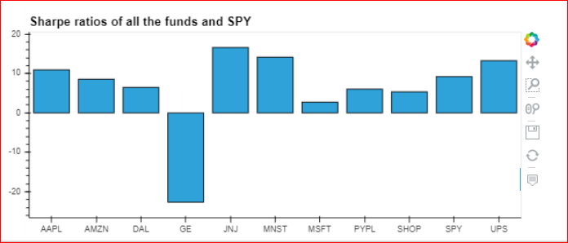
Standard Deviation
Daily and Annual
Sharpe Ratios

Slide 8
Postmortem Discuss any difficulties that arose, and how they were handled. Discuss any additional questions that arose, which couldn't be answered due to time constraints. What would you research next if you had two more weeks?

Slide 9
Libraries
import panel as pn pn.extension('plotly') import plotly.express as px import pandas as pd import hvplot.pandas import matplotlib.pyplot as plt import requests import urllib.request import os import json import seaborn as sns import yahoo_finance as yahoofin import yfinance as yf from yahoofinancials import YahooFinancials from datetime import date from pathlib import Path from dotenv import load_dotenv from datetime import date from pandas_datareader import data as pdr import numpy as np import seaborn as sns import yaml
Appendix
https://alexandrenesovic.com/2019/11/17/how-to-find-import-and-plot-historical-financial-data-with-yfinance-python-and-how-to-calculate-the-daily-returns/
https://marqueegroup.ca/resource/how-to-use-python-in-a-finance-environment/
https://stackoverflow.com/questions/55397178/dataframe-creation-from-dict-index-order
https://stackoverflow.com/questions/38133064/get-adj-close-using-pandas-datareader

Slide 10
Structure - Rough
KYC
Stock Selection Criteria
Portfolio Assignment & Analysis (start, close, 20 years, Average daily returns, correlation, cumulative, annualized standard deviation, Sharpe ratio, cumulative risk )
Plot
Monte Carlo
Beta
Isolate the stocks that have 20 years data – Original Portfolio
3 stocks that don’t have 20 years data we will do that separately
P/E Ratio
Visualization

